Slide 1
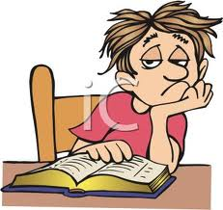
สรุปแนวข้อสอบ และตัวอย่าง

Slide 2
คำถาม – คำตอบ (ให้คำถามมาเพื่อเลือกคำตอบ หรือให้คำตอบมาเพื่อเลือกคำถาม)
ไวยากรณ์
- was/were;
- there is/there are; Is there/are there(?);
- future continuous tense (will be + v. ing)
- future perfect tense (will have + pp. v)
- word order (black hair or hair black)

Slide 3
คำศัพท์/ คำจำกัดความ/คำอธิบาย - ให้คำจำกัดความเพื่อหาคำศัพท์ - ให้ประโยคมาแล้วเติมคำศัพท์ที่ถูกต้อง - ให้ดูรูปแล้วให้เลือกว่าตรงกับคำว่าอะไร การฟัง - ดูรูปแล้วฟังประโยค ๔ ประโยคเพื่อเลือกว่าประโยคใดตรงกับรูป - ฟังบทสนทนาสั้นๆ (จากในหนังสือ) แล้วตอบคำถามเกี่ยวกับบทสนทนานั้นๆ

Slide 4
Questions
&
Responses

Slide 5
Do you travel alone? Are you travelling alone?
a. I’m fine, thank you.
Here you are.
No, I’m with my wife.
I have nothing to declare.

Slide 6
Q: “How long will you stay in Thailand?” A: “______________”
a. Last year.
b. Two weeks.
c. Yes, the trip is good.
d. No, I am travelling alone.

Slide 7
Q: “_____________” A: “I’m Canadian.”
a. What’s your nationality?
b. Where are you from?
c. What’s your country?
d. What’s your family name?

Slide 8
Q: “What’s the purpose of your visit to Thailand?” A: “______________”
a. Have a nice day.
b. I packed my own bags.
c. I’m here on vacation.
d. I’m hungry.

Slide 9
Q: “___________” A: “The fine is 2,000 baht.”
a. How much do you charge?
b. How much is it altogether?
c. How much does it cost?
d. How much is the overstay fine?

Slide 10
What did the lady lose?
a. He lost his luggage.
b. She lost her handbag.
c. He got lost in the duty free shop.
d. She found a leather handbag.

Slide 11
A: “Will I be able to take my stroller to the gate?” B: Certainly. Let me just put a special luggage tag on the stroller.
Where did the conversation take place?
a. At the Security Check Point
b. At the check-in Counter
c. At the Health Control Booth
d. At the Customs Counter

Slide 12
Would you like something to drink? This sentence can be heard _____
a. At the Baggage Claim
b. At the Check-in Counter
c. On the airplane
d. At the Immigration Booth

Slide 13
Grammar

Slide 14
In London, _____ a lot of museums.
a. there is
b. there are
c. Is there
d. Are there

Slide 15
______ some water in the bottle.
a. There is
b. There are
c. Is there
d. Are there

Slide 16
____ some good Thai restaurants in Germany?
a. There is
b. There are
c. Is there
d. Are there

Slide 17
The flight arrived ____ Singapore _____10:30 o’clock.
a. in, at
b. at, at
c. on, at
d. to, on

Slide 18
The flight from Japan yesterday _____ terrible.
a. is
b. was
c. are
d. were

Slide 19
Tonight at 7:00 p.m. Somkid __________ dinner with his family.
a. will have
b. will be having
c. will have had
d. will have gone

Slide 20
Which sentence is correct?
a. People red-haired have often freckles.
b. People red-haired often have freckles.
c. Red-haired people often have freckles.
d. Red-haired people have often freckles.

Slide 21
What is the opposite of “rude”?
a. Short
b. Beautiful
c. Straight
d. Gentle

Slide 22
Vocabulary
And
Description

Slide 23
_____ have been going to America for hundreds of years.
a. Immigration
b. Immigration Office
c. Immigration Officer
d. Immigrants

Slide 24
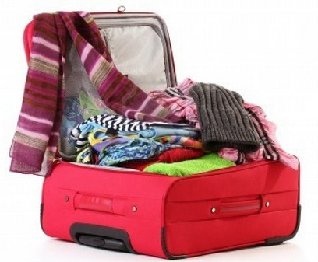
Which of the following doesn’t belong to the group?
Luggage
Suitcase
Baggage
Handbag

Slide 25
A small usually pointed beard grown only on the chin, not the cheeks
Ponytail
Mohawk
dreadlocks
goatee

Slide 26
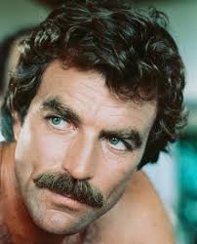
He is a man with ________.
a. Beard
b. Moustache
c. Goatee
d. freckles

Slide 27
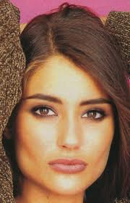
She has a ________ face.
a. round
b. Square
c. Oval
d. Long

Slide 28
Which word can be used to replace “luggage cart”?
a. Baggage
b. Carousel
c. Trolley
d. Bin

Slide 29
All documents must be ______.
fake
original
Thai
colorful

Slide 30
The area in an airport where arriving passengers collect luggage that has been carried in the hold of the aircraft.
a. Customs office
b. Baggage claim
c. Immigration booth
d. Duty free

Slide 31
A flat pocket-sized folding case, usually made of leather, for holding paper money, cards, or photographs.
a. Handbag
b. Briefcase
c. Suitcase
d. wallet

Slide 32
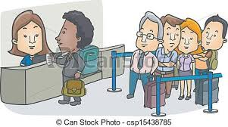
The man is standing ________.
a. behind the line
b. through a metal detector
c. near the luggage carts
d. in front of the counter

Slide 33
A machine that you walk through that determines whether you have any metal objects on you.
a. Conveyor belt
b. Metal detector
c. Luggage carousel
d. Trolley cart

Slide 34

What’s the meaning of this sign?
Right turn only
Go straight ahead
Walk down the escalator
No turns

Slide 35
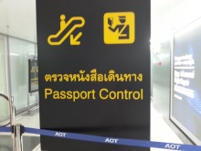
How do you go to Passport Control?
a. Up the escalator
b. Down the escalator
c. Up the elevator
d. Down the elevator

Slide 36
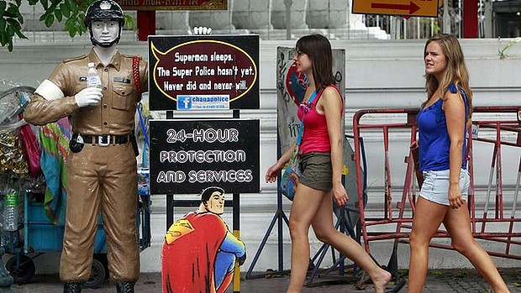

Answer: a b c d

Slide 37
Picture 1
a. There is a statue in the center of the road.
b. There are two girls wearing jeans.
c. There aren’t any cars on the road.
d. The girls have long hair.

Slide 38
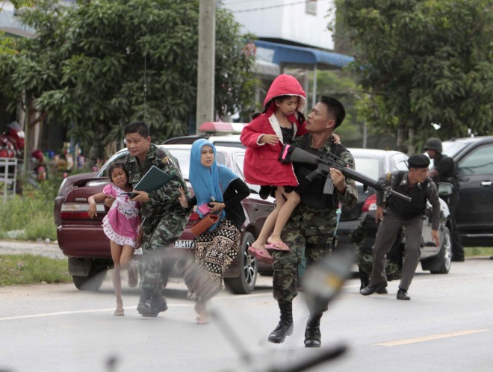
Answer: a b c d

Slide 39
Picture 2
a. Everyone is running.
b. The little girl has a gun.
c. The woman is shouting.
d. The people are in a forest.

Slide 40
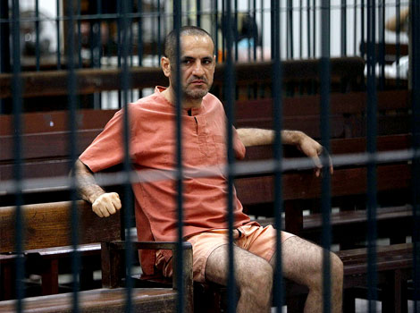
Answer: a b c d

Slide 41
Picture 3
a. He’s standing in a prison cell.
b. There are many prisoners in the cell.
c. He’s wearing shorts.
d. He’s shouting at the police.

Slide 42
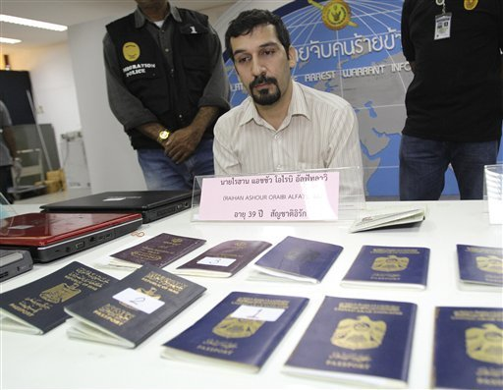
Answer: a b c d

Slide 43
Picture 4
a. The man didn’t have any passports.
b. The man sitting down has a beard and a moustache.
c. The passports on the table are all from the same country.
d. All of the men are sitting at the table.

Slide 44
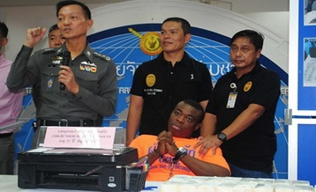
A
Answer: a b c d

Slide 45
Picture 5
a. The officers are saluting.
b. There is a machine on the table.
c. Two men are sitting at the table.
d. He’s shouting at the policeman.

Slide 46
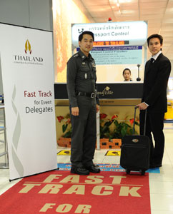
Answer: a b c d

Slide 47
Picture 6
a. The officer is standing behind the Fast Track mat.
b. The passenger has a large, shiny white suitcase.
c. The man are looking at each other.
d. The Fast Track is for Delegates.

Slide 48
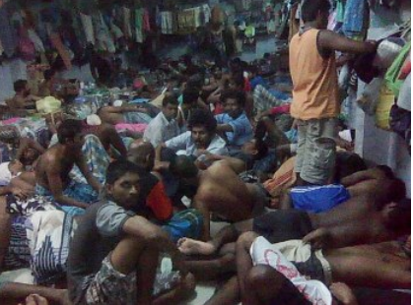
Answer: a b c d

Slide 49
Picture 7
a. There are many people in the room.
b. All of the people are lying down on the floor.
c. The people are all wearing shirts.
d. The room has many lights.

Slide 50
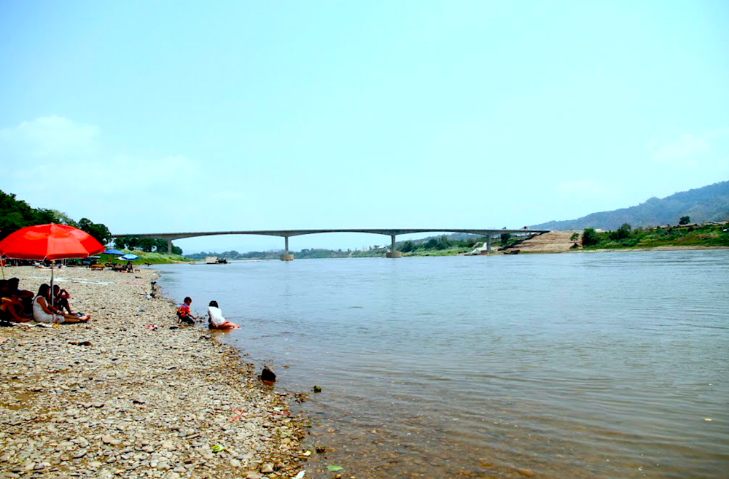
Answer: a b c d

Slide 51
Picture 8
There are people standing in the river.
There is an umbrella in the river.
There are people under the umbrella.
There are many tall trees in the river.

Slide 52
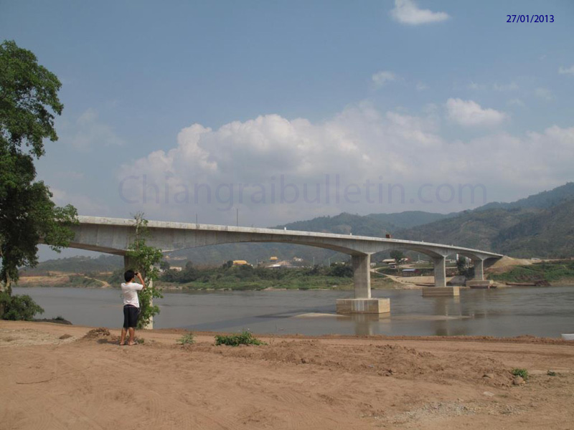
Answer: a b c d

Slide 53
Picture 9
a. There is a bridge across the river.
b. The river is flooding.
c. A person is standing under the bridge.
d. Many trucks are driving across the bridge.

Slide 54
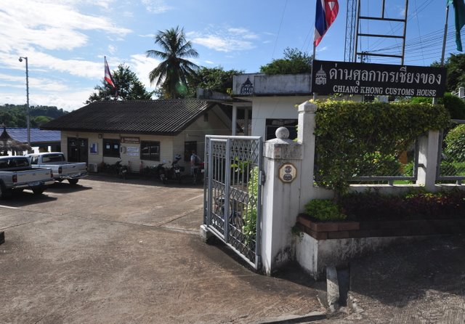
Answer: a b c d

Slide 55
Picture 10
There are flags on the flagpoles.
The Customs House is a very big building.
There are many pick-ups in front of the Customs Building.
It is raining.

Slide 56
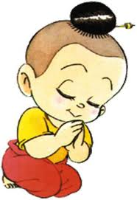
Thank you

Slide 57
Question 1
A. She lost her handbag.
B. She lost her friend.
C. She got lost in the duty-free shop.
D. He lost his handbag.

Slide 58
Question 2
A. It’s a leather handbag.
B. It’s a bright purple leather handbag.
C. She lost her handbag.
D. It’s a bright pink leather handbag.

Slide 59
Question 3
A. At her home.
B. At the duty-free shop.
C. At the coffee shop
D. She lost her handbag.

